Slide 1
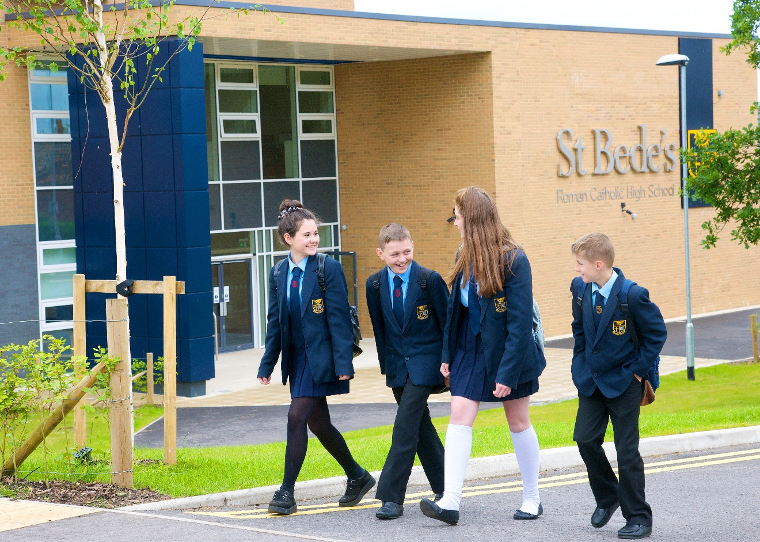

Slide 2
College Staff
Mrs Bilsborough /Mrs Wilson Arrowsmith (Green)
Mrs Houston/Mrs Shannon Plessington (Red)
Mrs Jose/Miss Whitaker Rigby (Blue)
Mr Walsh/Mrs Lingard Southworth (Yellow)

Slide 3
Information about St. Bede’s
You should aim to be in school before 8.15am when the first bell goes!
Lunch app
Each lesson is an hour and you have 5 lessons per day
After school clubs
SMHW App

Slide 4
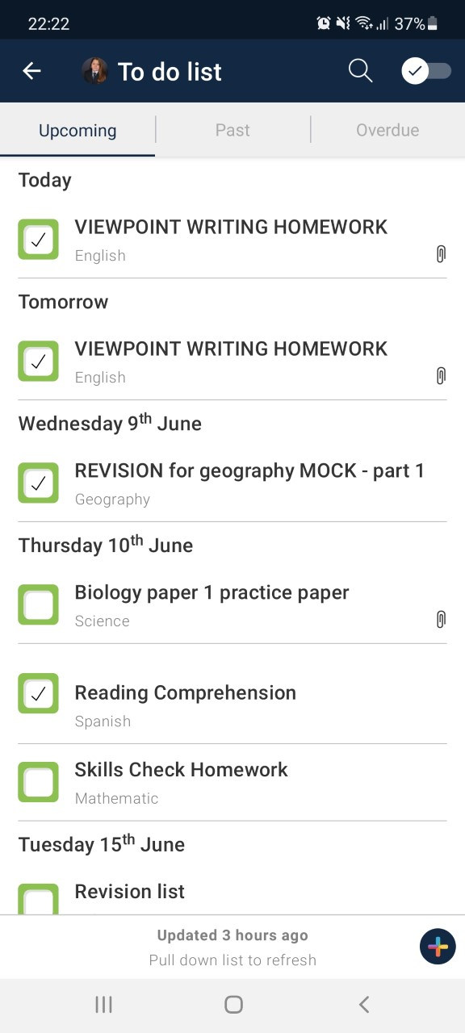
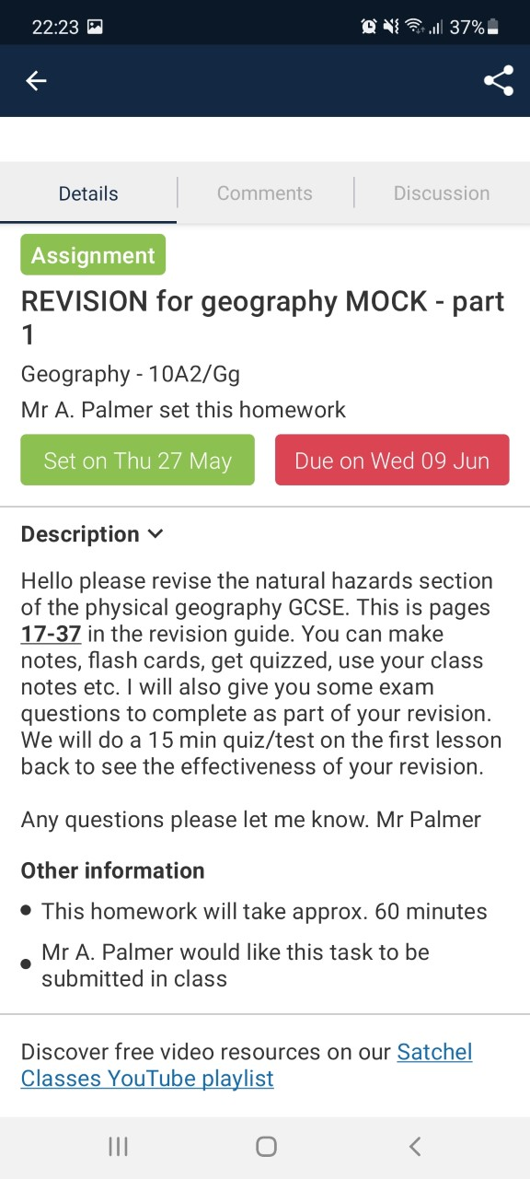
SMHW

Slide 5
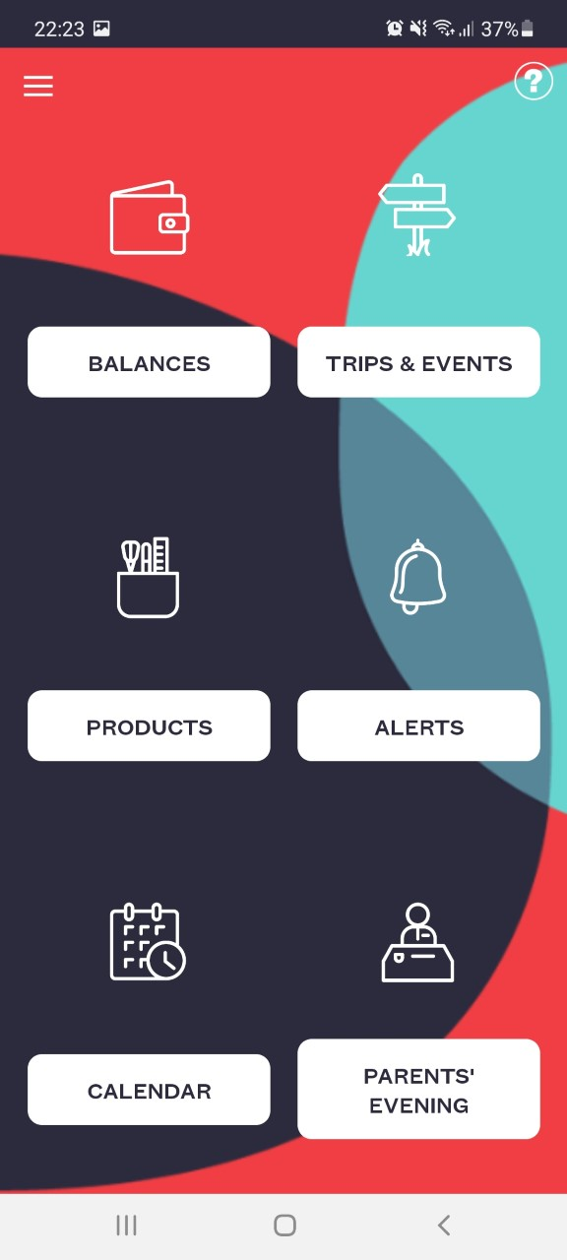
SCOPAY

Slide 6
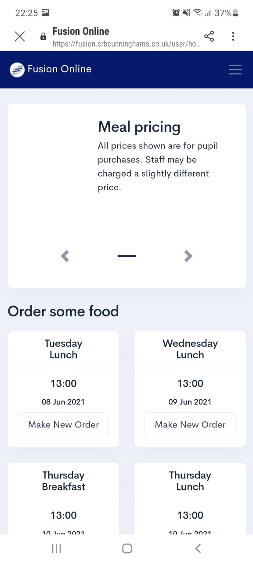
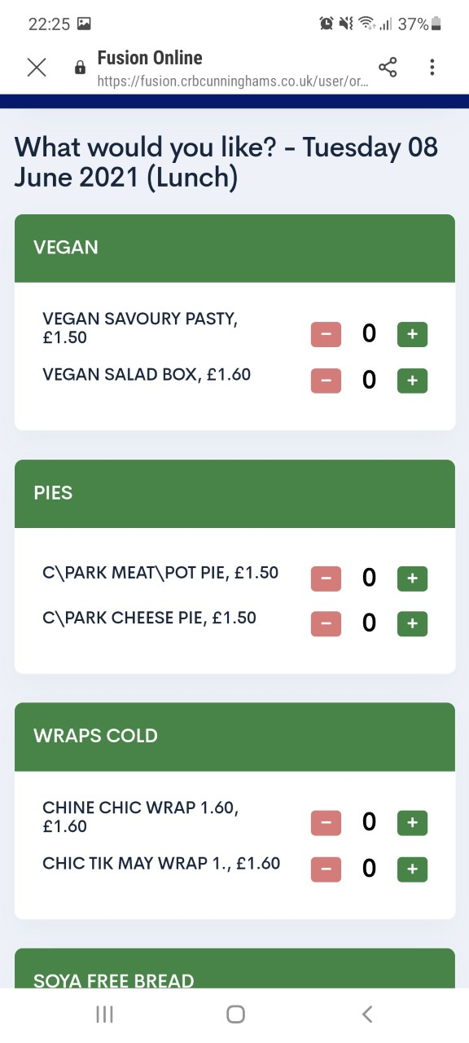
Fusion Mobile

Slide 7
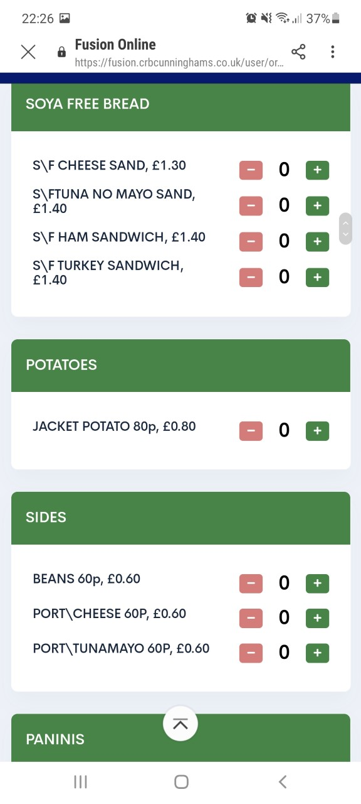
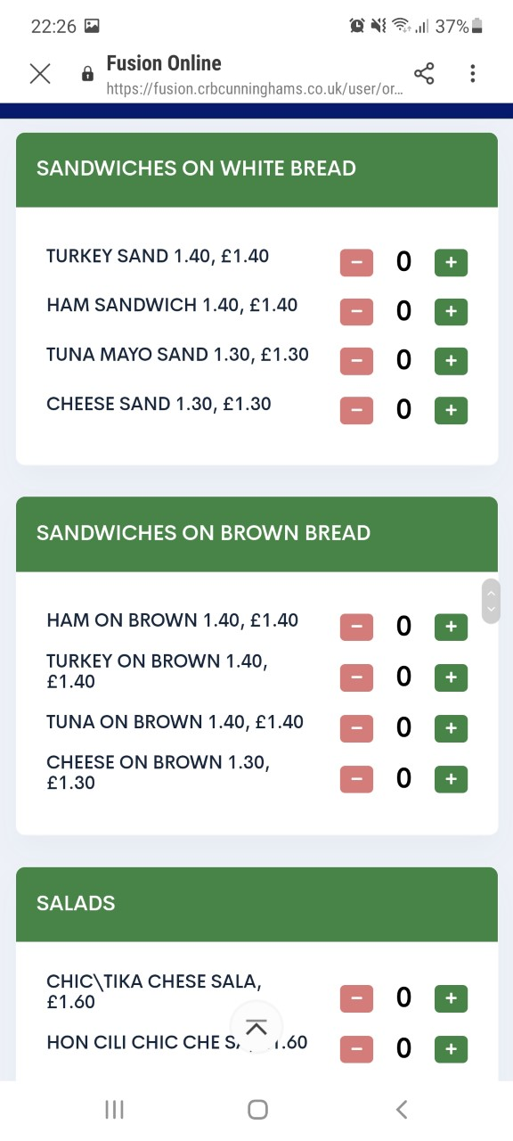
Fusion Mobile

Slide 8
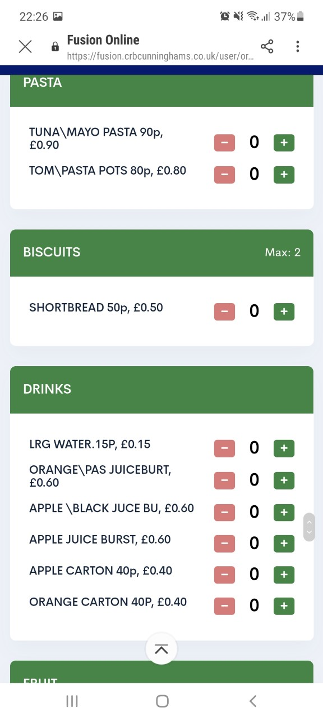
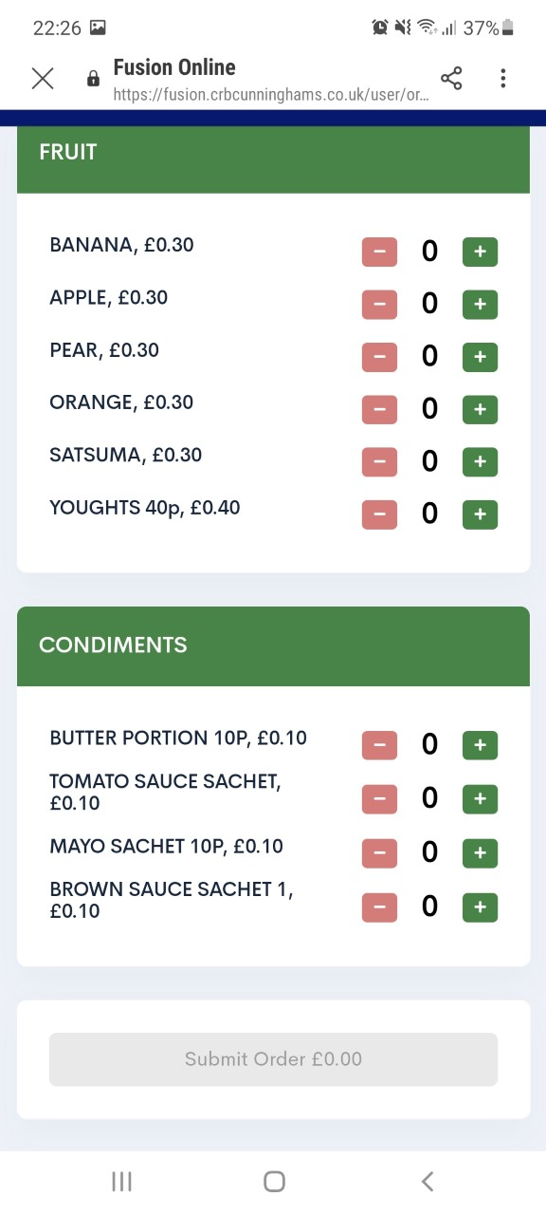
Fusion Mobile

Slide 9
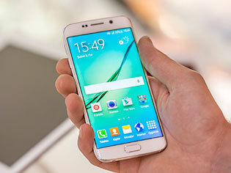
Mobile phones
You may bring a mobile phone if:
It is switched off from the moment you enter St. Bede’s gate, until the moment you leave.
You keep it in your pocket or your bag
It is your responsibility!
If you urgently need to contact home during the school day, you see your pastoral manager or Head of College.
If you use it in school it will be taken from you until your parent can come and collect it.

Slide 10
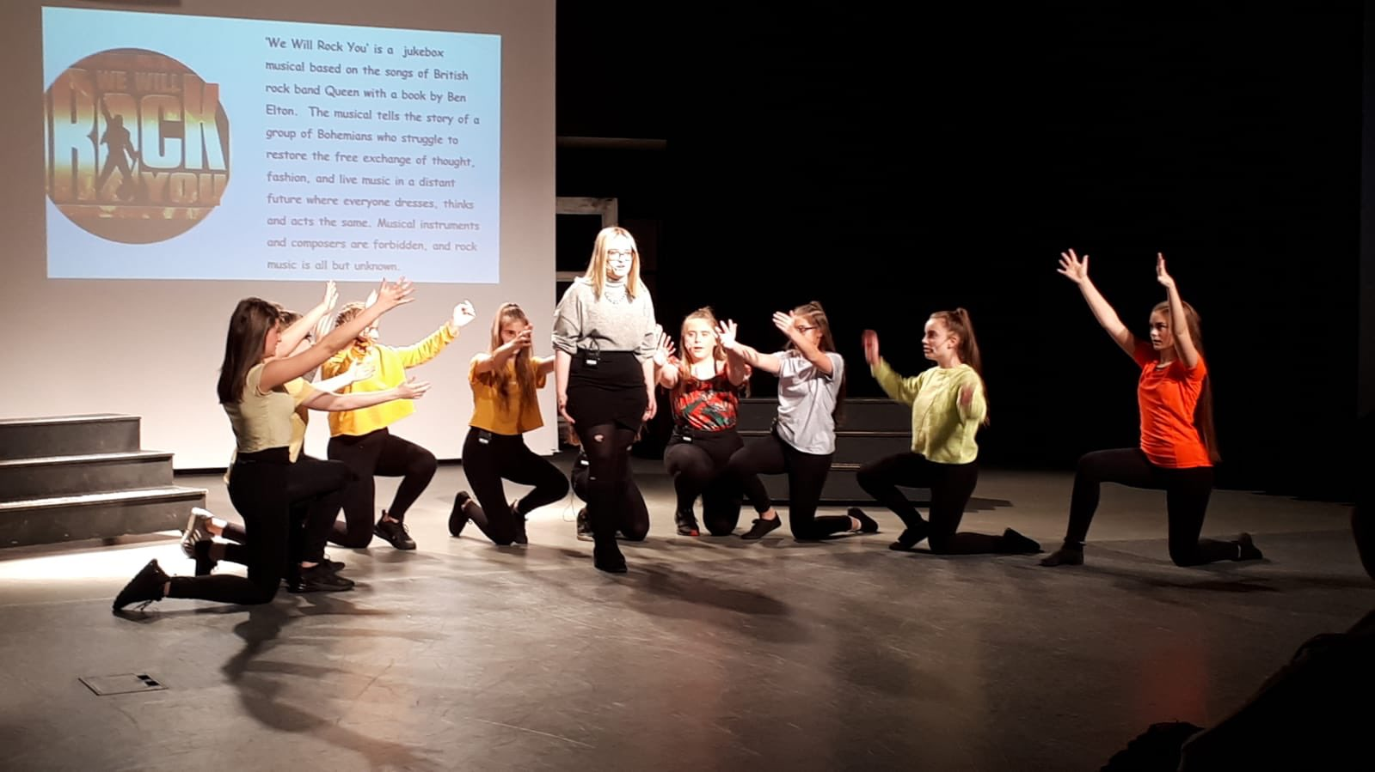
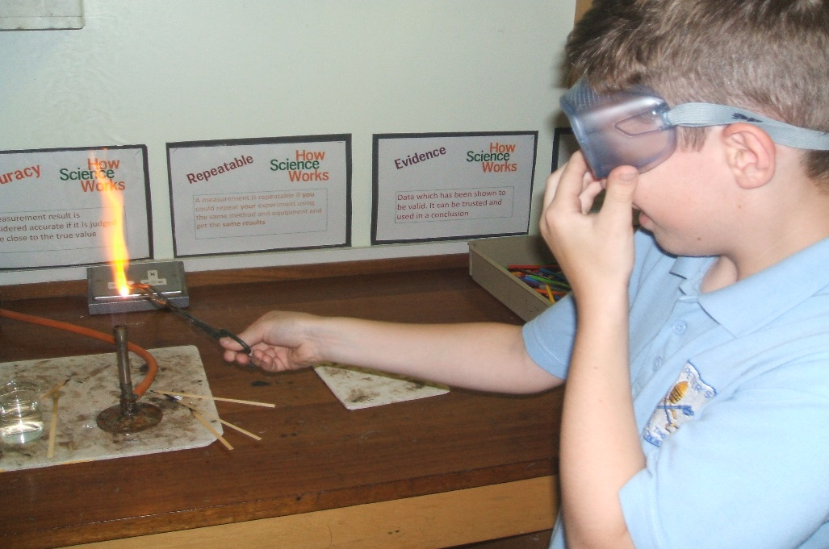
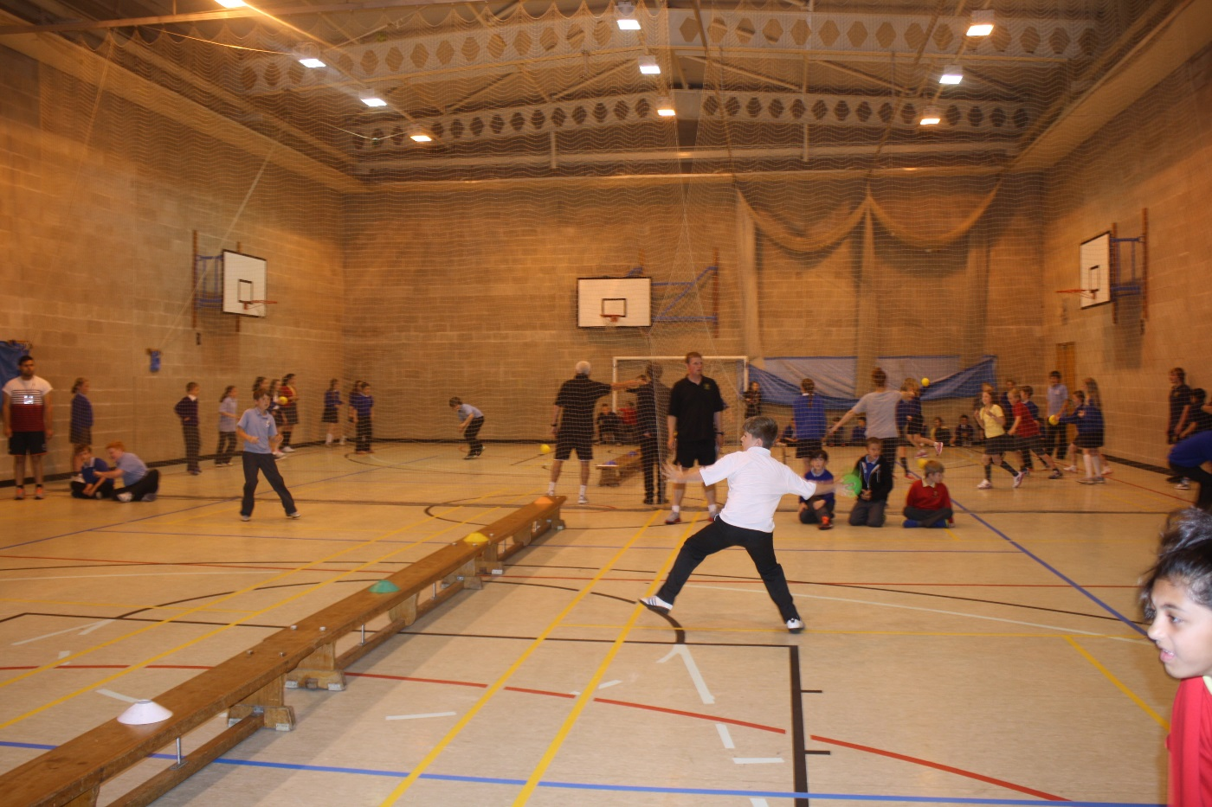
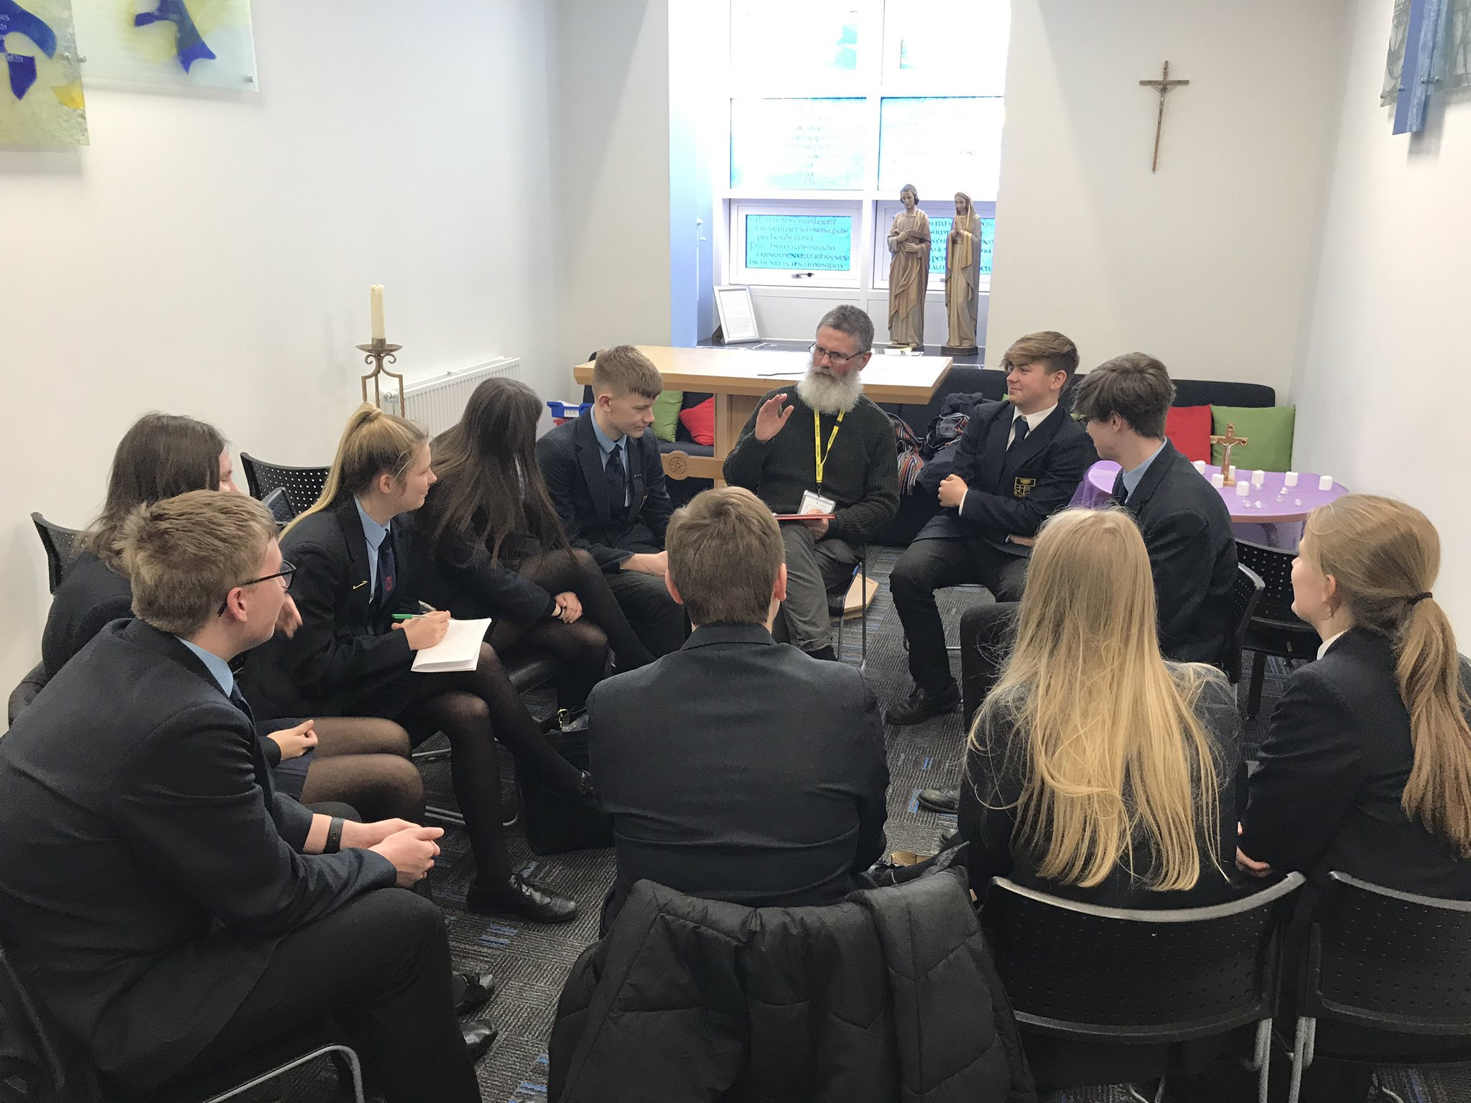

Slide 12
Sports

