Slide 1




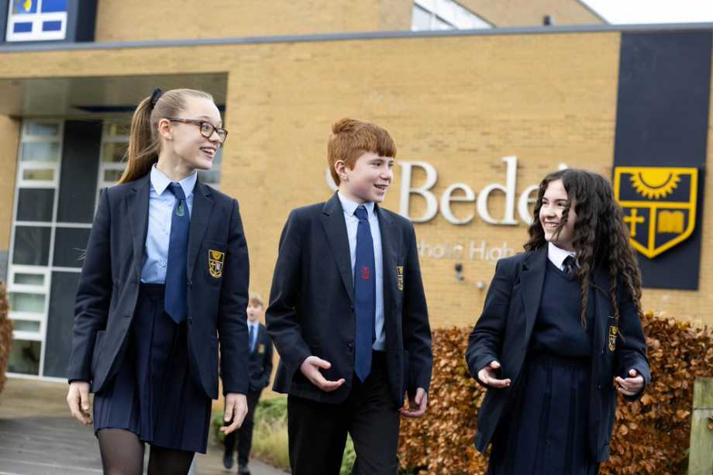

Slide 2
Induction Days
Wednesday 2nd July – Thursday 3rd July
Arrival 9.30am
Wear your primary school
Short Welcome Assembly – meet key staff
Prep session – meet your tutor and children from other schools
Bring trainers
Sample lessons
At lunch time you can either bring a packed lunch or be provided with a complimentary lunch from our canteen
Bring your trainers
Bring a snack and drink for the day
Tour of the school
You will be given information about the Curriculum Taster Day
Finish 2.30pm

Slide 3
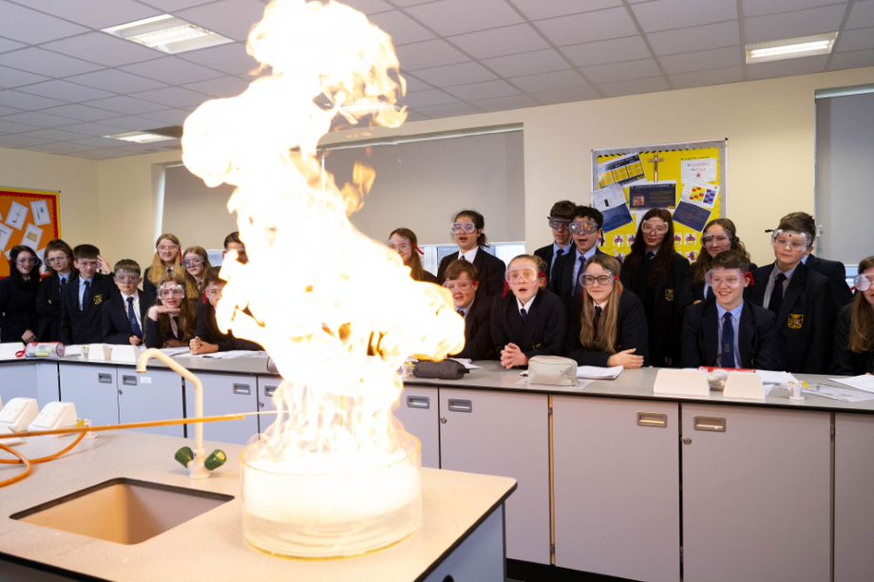
Curriculum Taster Day – Thursday 3rd July
Travel to and from school as you would do in September
A free bus pass will be given for school buses only
You will be given a timetable of lessons that you will take part in
Meet a variety of different staff and sample different subjects
Bring a packed lunch or be provided with a lunch from our canteen
Bring a drink and snack
Bring trainers

Slide 4
Important information about your new school

Slide 5
The school gate opens at 8am. You should aim to be in school before 8.10am when the first bell goes
Each lesson is an hour and you have 5 lessons per day
You should try to use the toilet at break and lunch to avoid missing lesson time
At St Bede’s you earn rewards by collecting reward points called ‘bedes’. These are rewarded for good attitude to learning in lessons, wearing your uniform correctly, good punctuality and attendance.
You can also lose ‘bedes’ by wearing your uniform incorrectly, poor behaviour in lessons and on the yard and being late to school.
‘Bede’ points earn you a reward at the end of each term

Slide 6
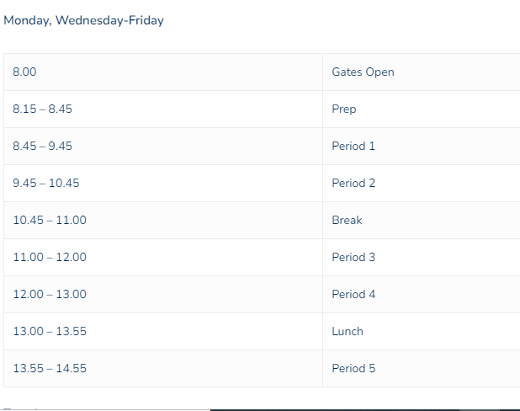
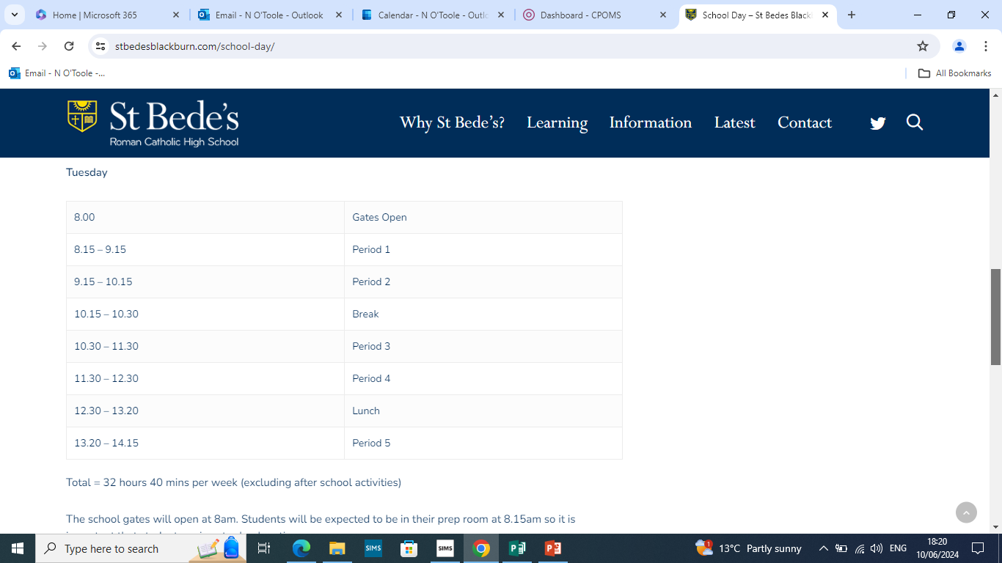
The school Day

Slide 7
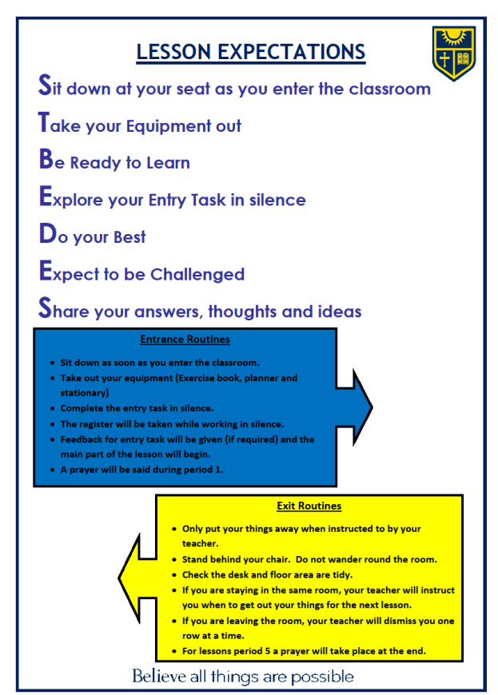
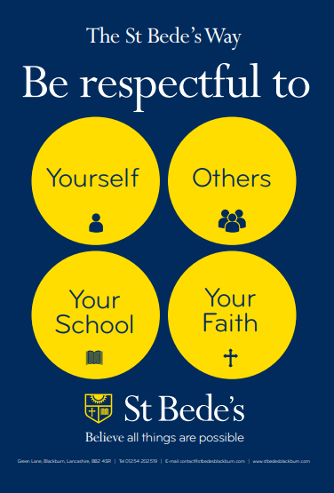
Expectations

Slide 8
ATTENDANCE MATTERS
“Just one day off” can soon add up…
95% attendance over the academic year equates to 10 school days absence. This is 2 full weeks of missed learning.
90% attendance over the academic year is equal to 1 day off every 2 weeks. This is over 3 school weeks of missed learning
Top 10 pupils who made the most progress – 99.7%
Bottom 10 pupils who made the least progress – 88.9%
Notes:
EXCEPTIONAL CIRCUMSTANCES
15 SCHOOL DAYS
ATTENDANCE = ACHIEVEMENT

Slide 9
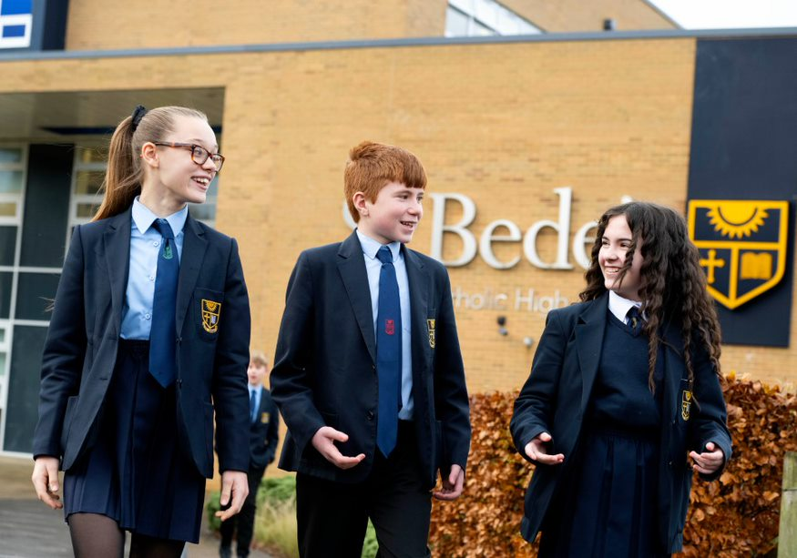
UNIFORM
Option A or B
House colour tie
Plain black school shoes
Black tights or plain white socks (skirt)
Black socks (trousers)
No make-up, false nails, varnish, false lashes or jewellery
Navy blue/black outdoor coat
Hairstyles – no extreme colour/cut
Notes:
UNIFORM CARD
UNIFORM POLICY

Slide 10
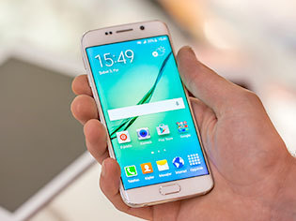
Mobile phones
You may bring a mobile phone if:
It is switched off
You keep it in your pocket or your bag
You understand it is your responsibility
If you urgently need to contact home during the school day, you see a member of your Year Team.
If you use it in school (seen or heard) it will be taken from you until your parent/carer can come and collect it.

Slide 11

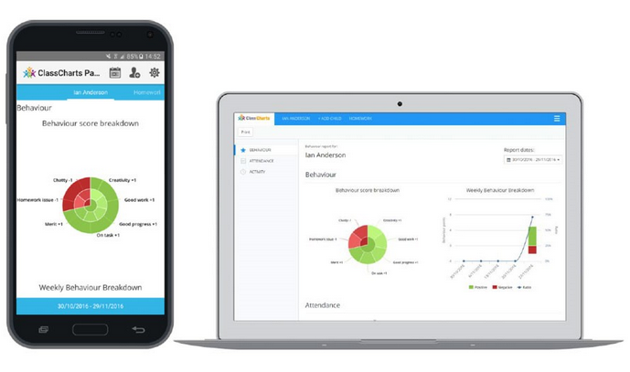
CLASS CHARTS APP
Tracks Behaviour for Learning, Timetable, Personal Study & Extra Curricular
Parents/carers can monitor their child’s school life and progress
Announcements – Daily messages
You will be given an access code to sign into your account

Slide 12

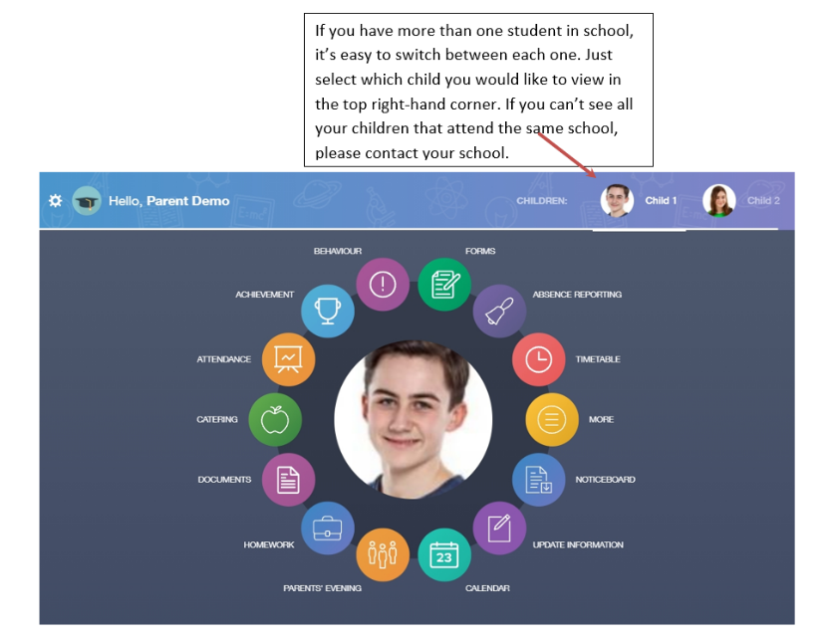
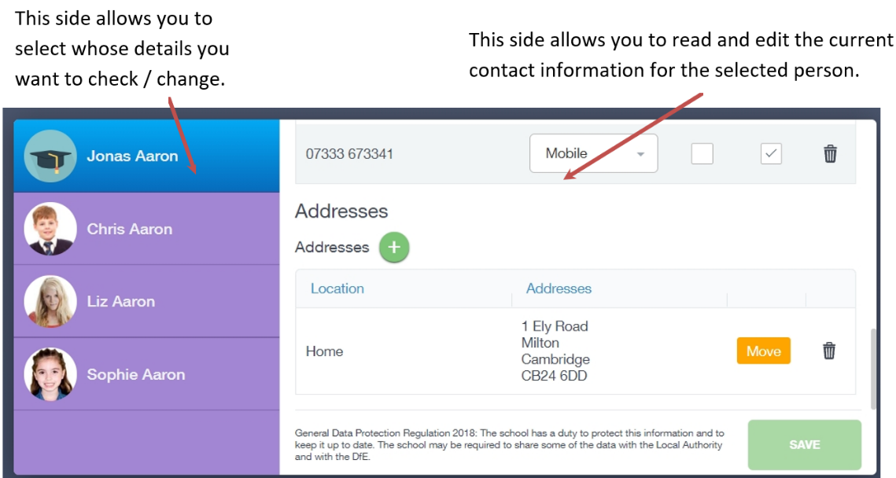
EDULINK APP
Parents/Carers can update personal information and contact details
View Assessments and reports
You will be issued a login by ICT Support (it will be the same as your computer login)

Slide 13
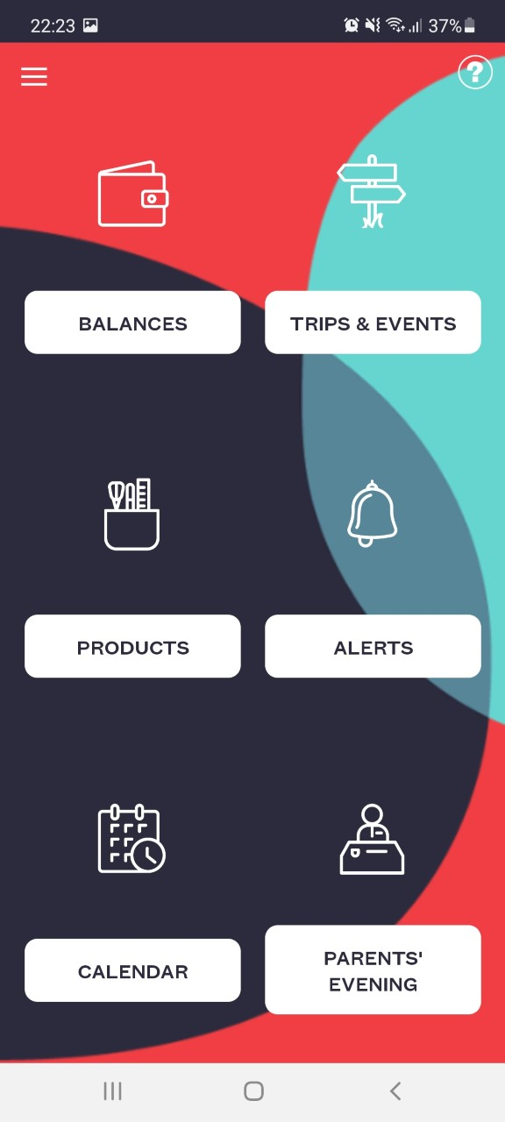
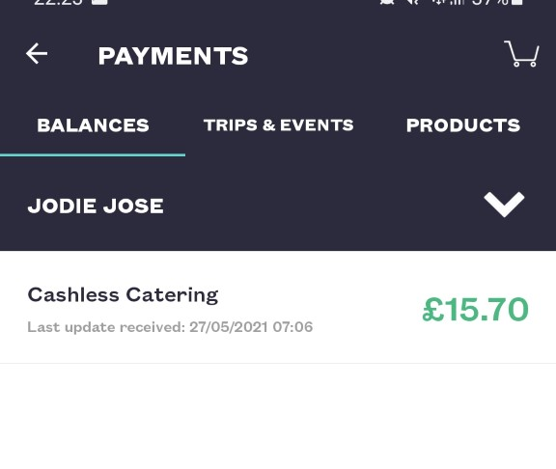
SCOPAY
This app is used to top up your lunch card and pay for school trips etc.

Slide 14
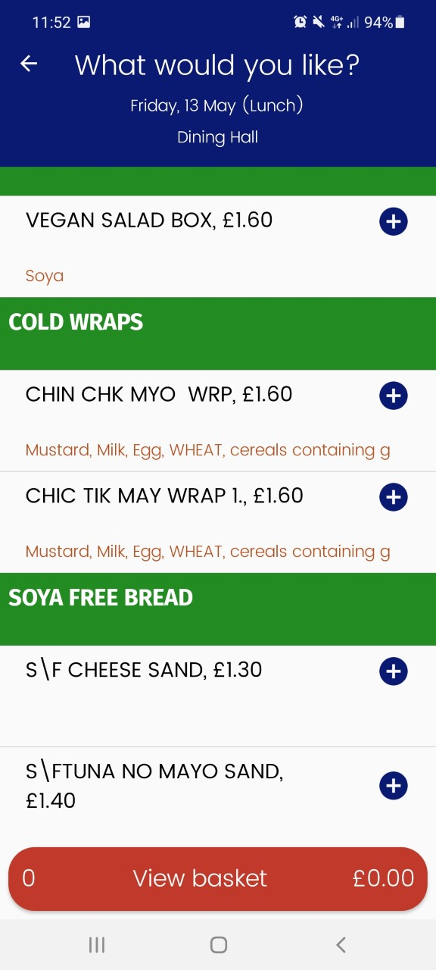
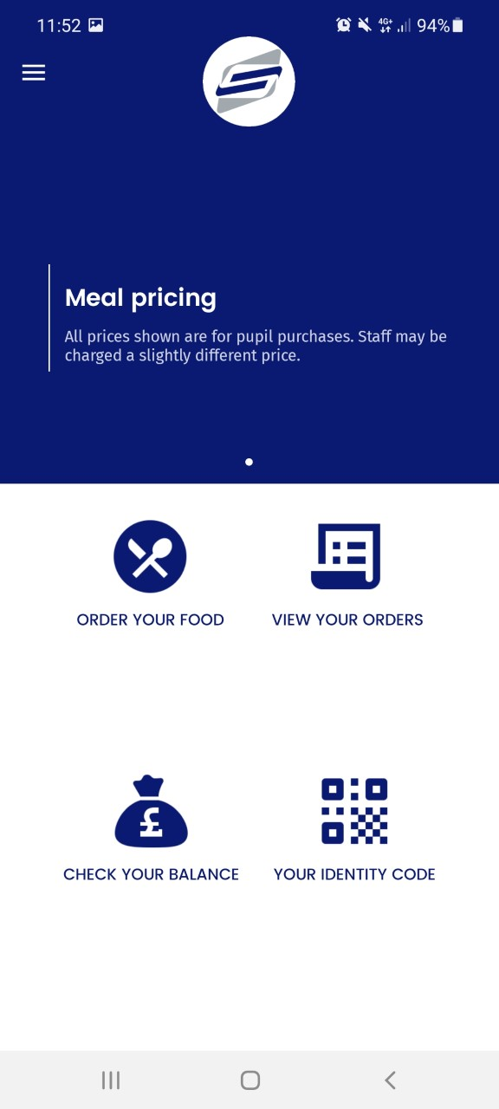
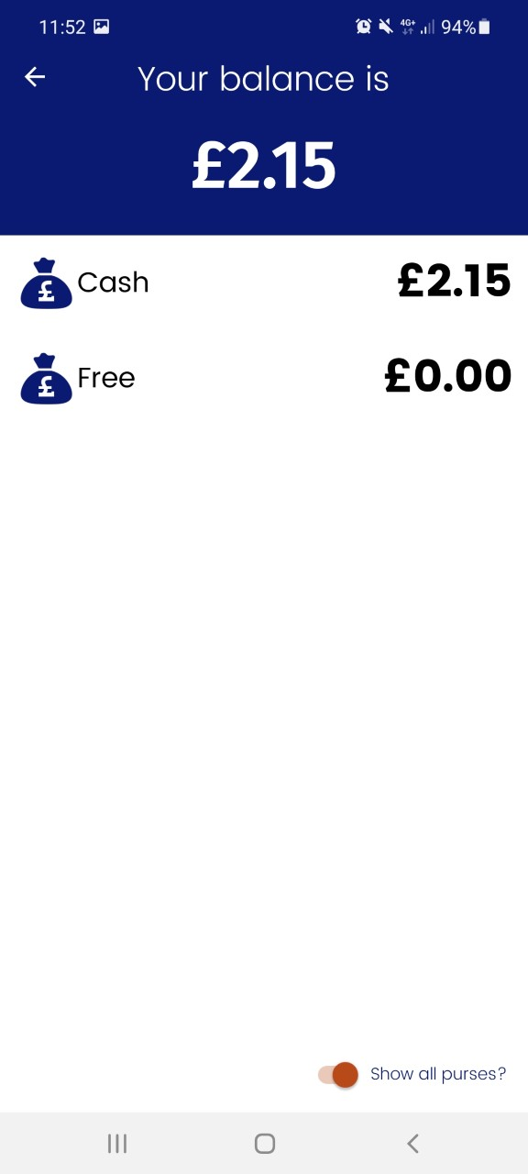
Fusion Mobile – this app is used to pre-order you lunch if you wish to

Slide 15
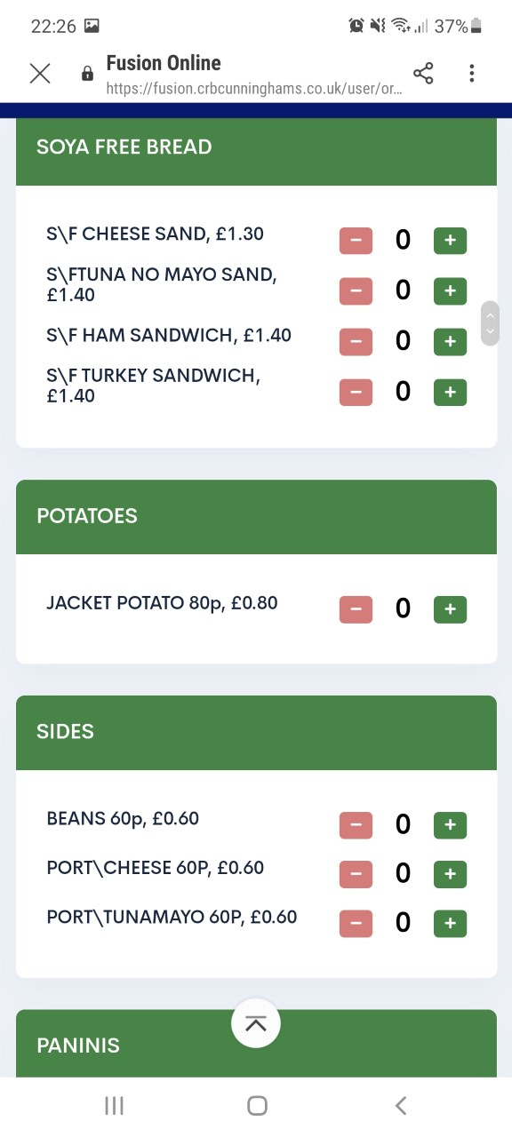
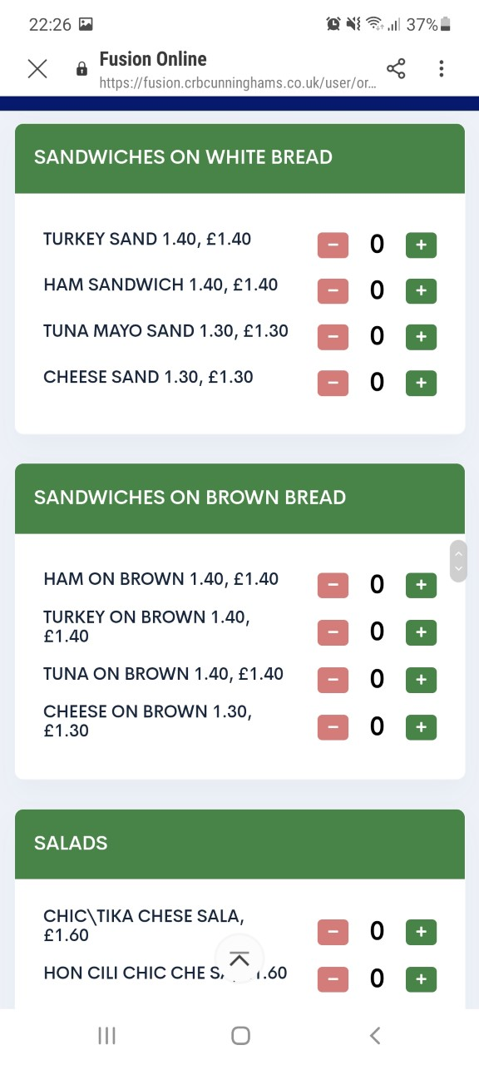
Fusion Mobile

Slide 16
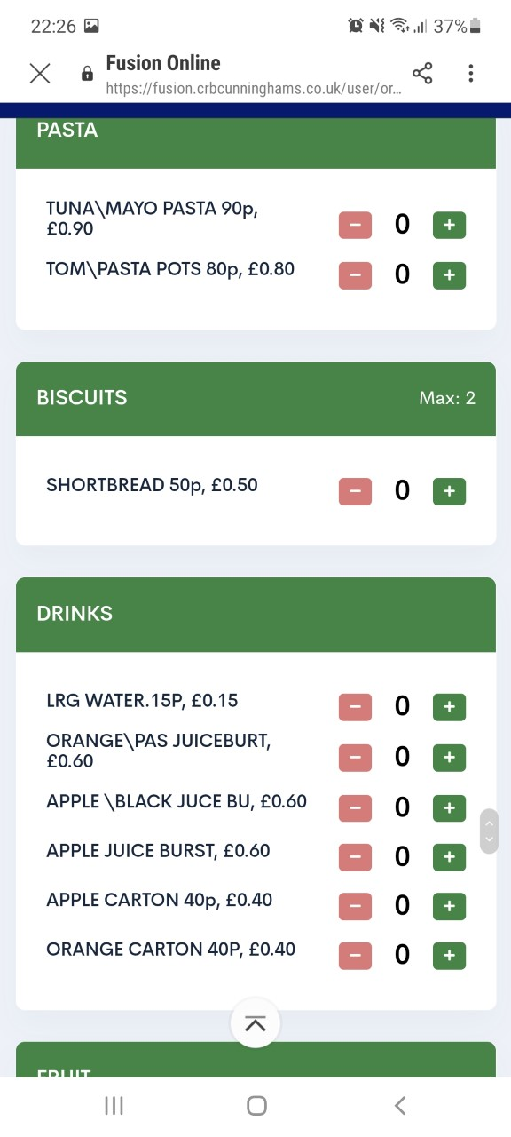
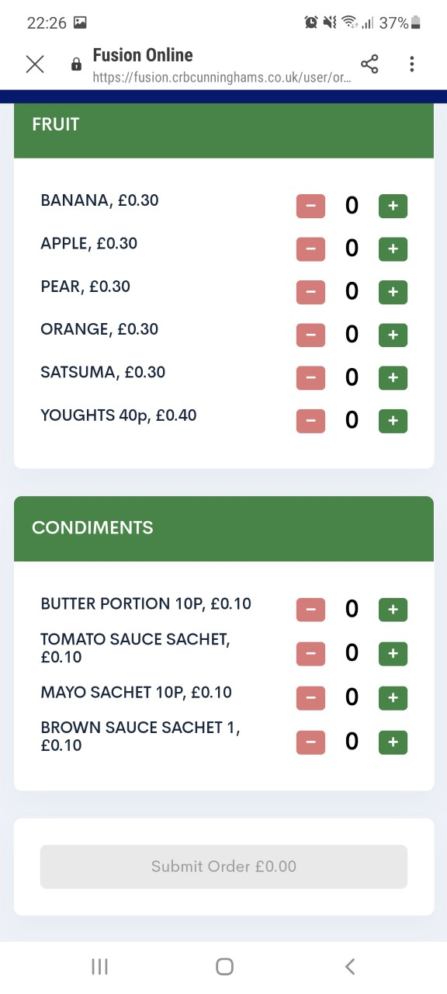
Fusion Mobile

Slide 17
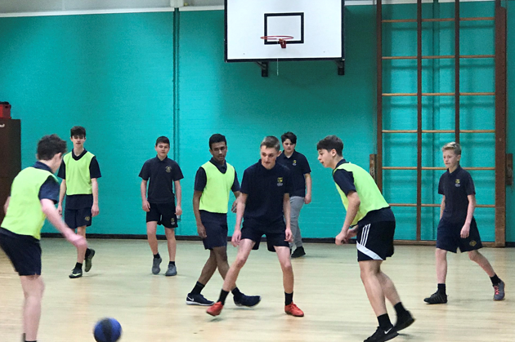
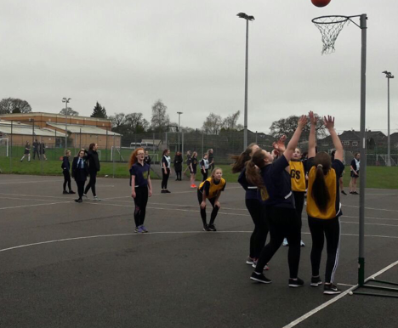
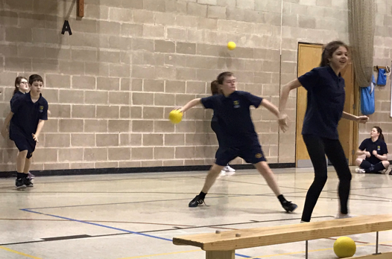
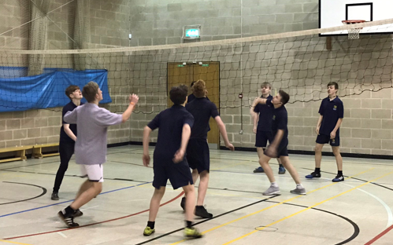
Extra-Curricular - https://www.stbedesblackburn.com/extracurricular/

Slide 18
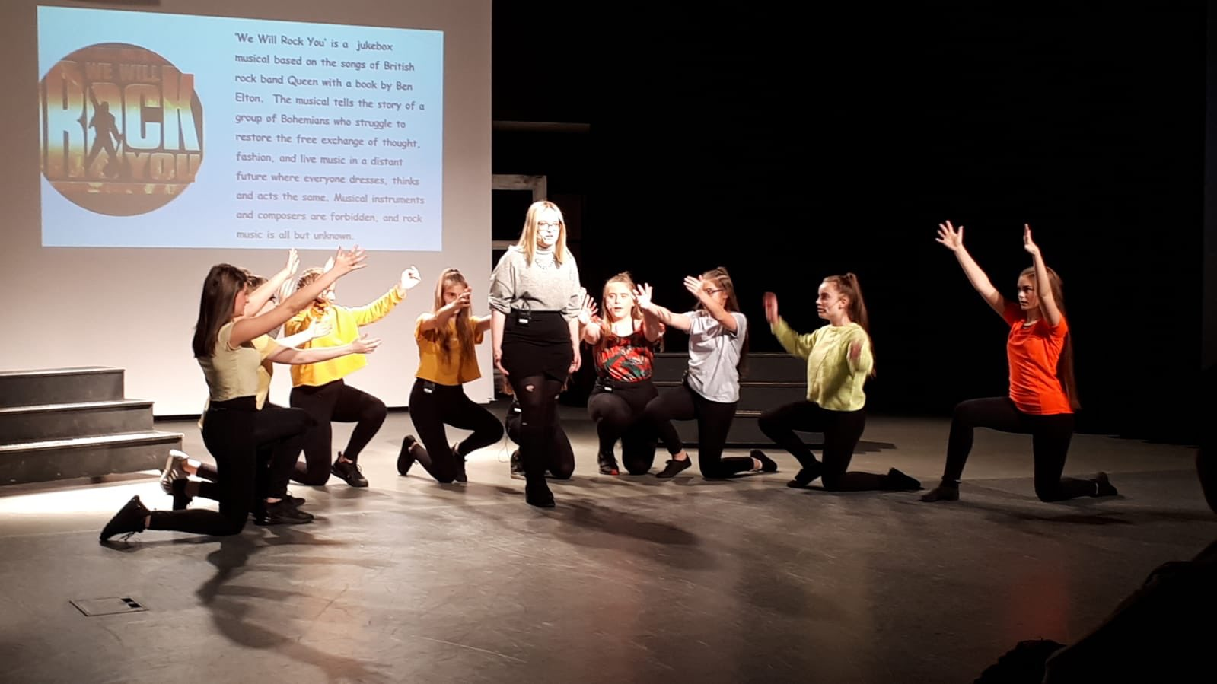
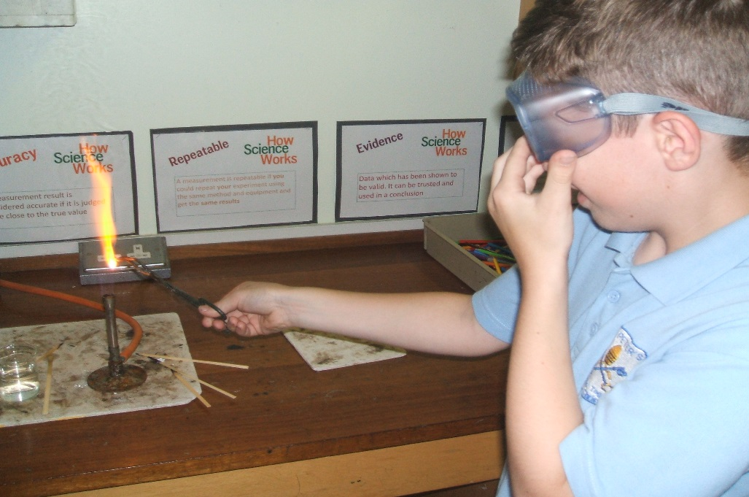
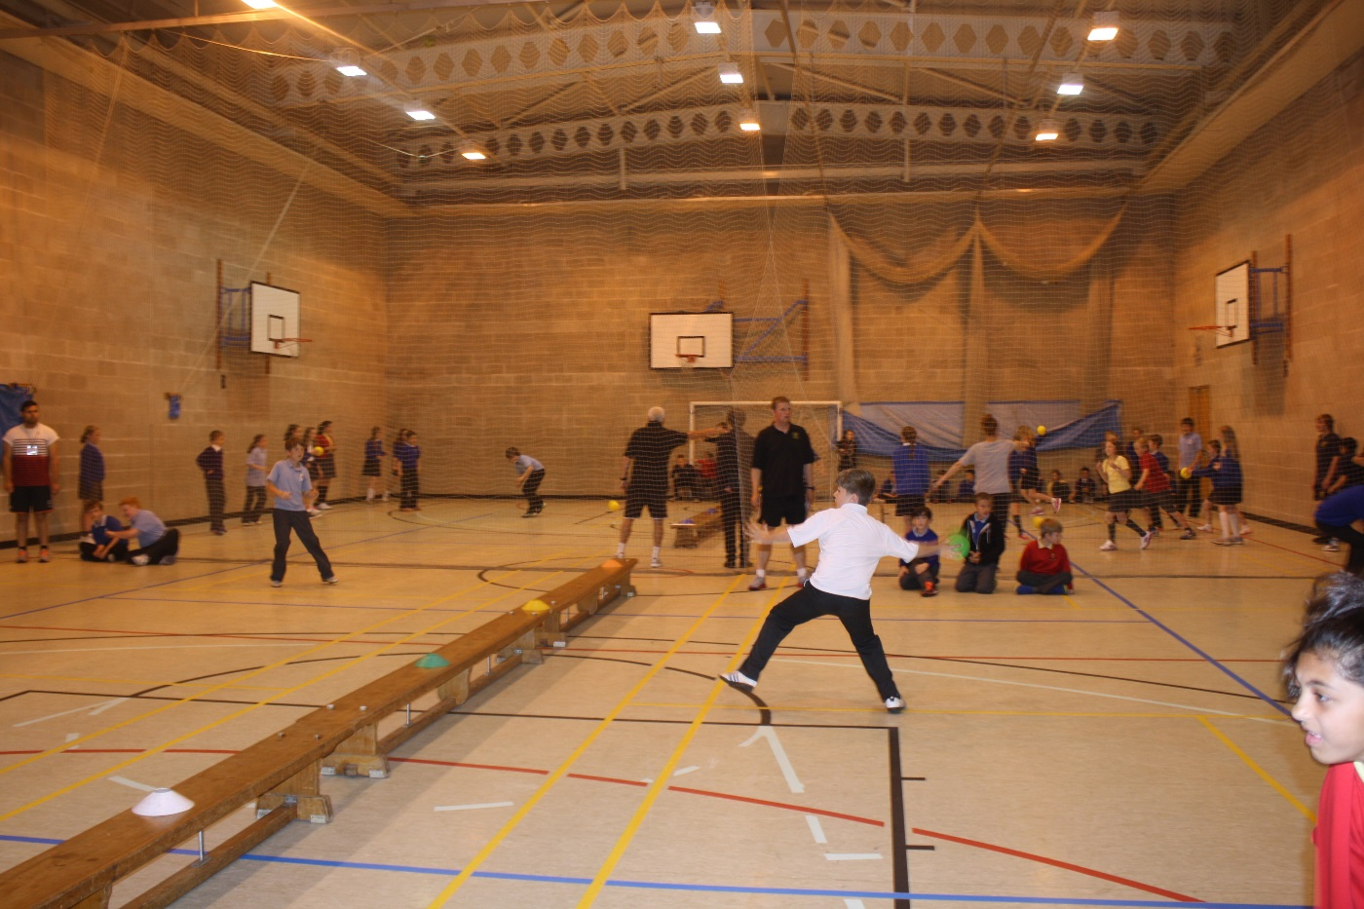
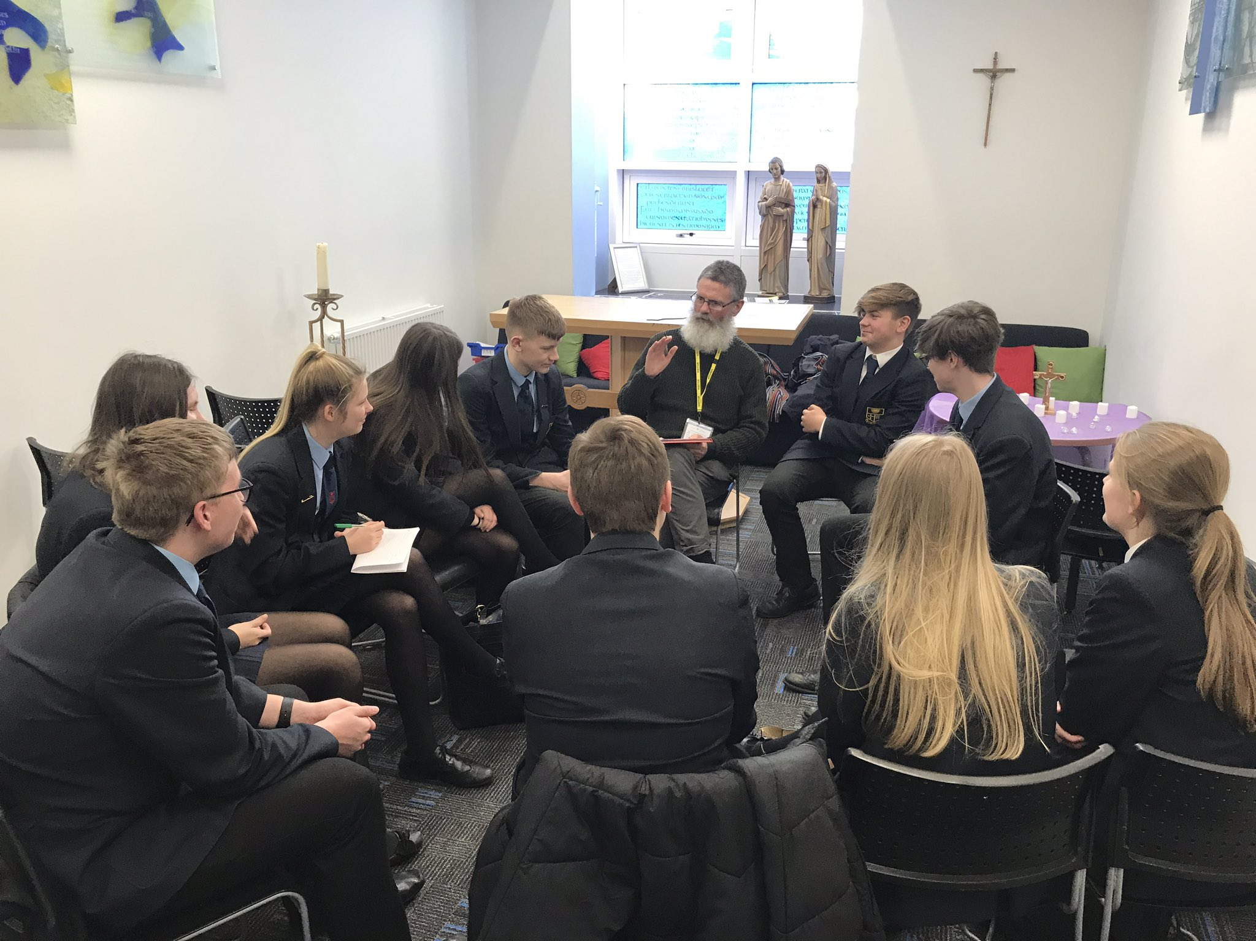

Slide 19
