Slide 1
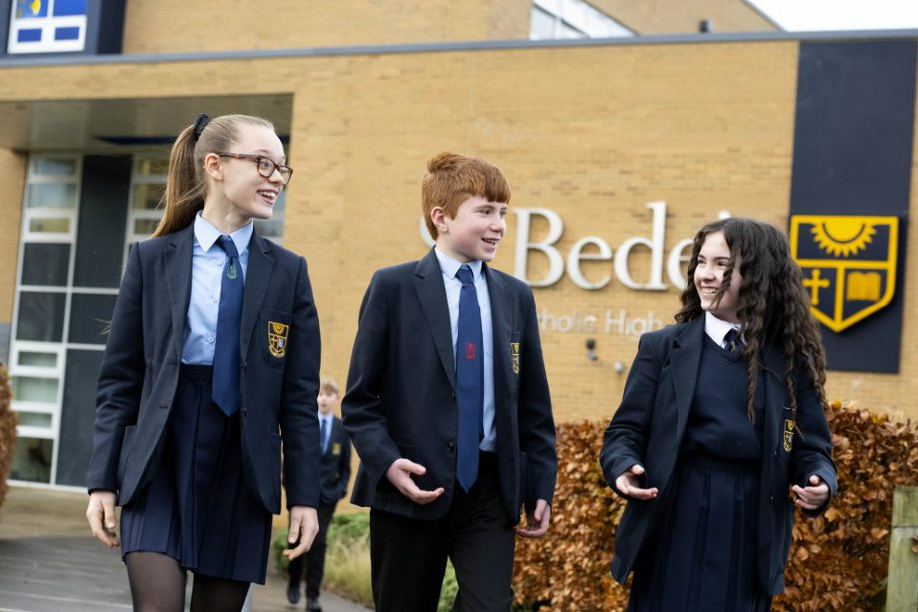

Slide 2
Induction Days Wednesday 3rd July – Thursday 4th July
Arrival 9.30am
Wear your primary school
Short Welcome Assembly – meet key staff
Prep session – meet your tutor and children from other schools
2 lessons
At lunch time you can either bring a packed lunch or be provided with a complimentary lunch from our canteen
Bring a snack and drink for the day
Tour of the school
You will be given information about the Curriculum Taster Day
Finish 2.30pm

Slide 3
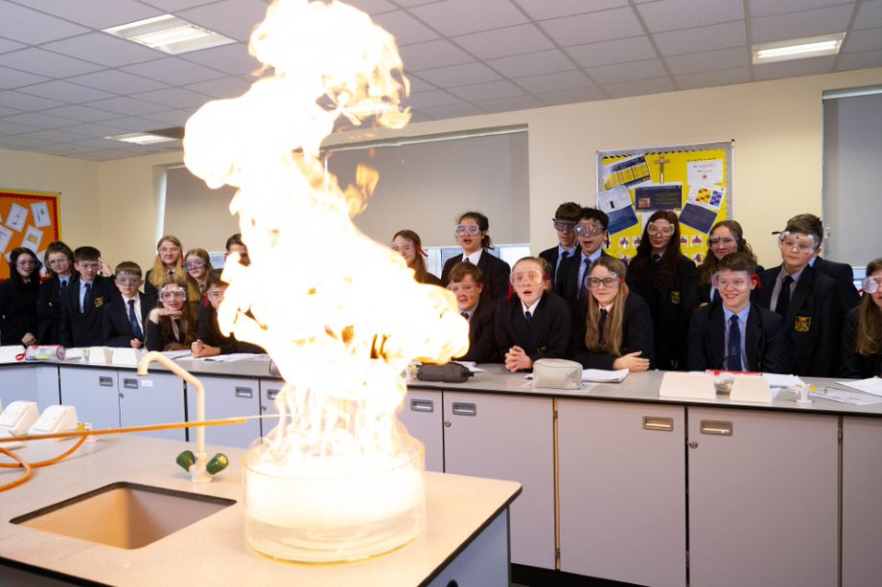
Curriculum Taster Day – Thursday 4th July
Travel to and from school as you would do in September
A free bus pass will be given for school buses only
You will be given a timetable of lessons that you will take part in
Meet a variety of different staff and sample different subjects
Bring a packed lunch or be provided with a lunch from our canteen
Bring a drink and snack
PE – trainers
Maths - calculator

Slide 4
Important information about your new school

Slide 5
The school gate opens at 8am. You should aim to be in school before 8.15am when the first bell goes
Each lesson is an hour and you have 5 lessons per day
You should try to use the toilet at break and lunch to avoid missing lesson time
At St Bede’s you earn rewards by collecting reward points called ‘bedes’. These are rewarded for good attitude to learning in lessons, wearing your uniform correctly, good punctuality and attendance.
You can also lose ‘bedes’ by wearing your uniform incorrectly, poor behaviour in lessons and on the yard and being late to school.
‘Bede’ points earn you a reward at the end of each term

Slide 6
The school Day

Slide 7
Expectations

Slide 8
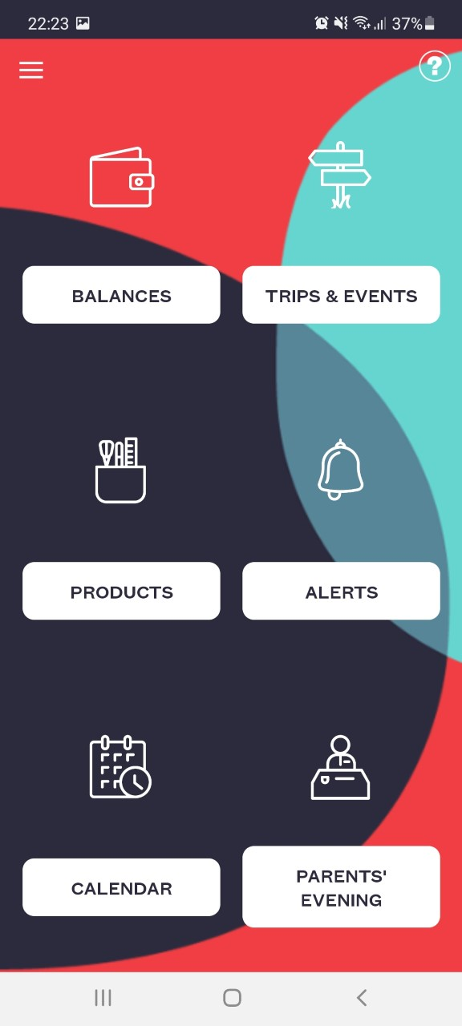
SCOPAY This app is used to top up your lunch card and pay for school trips etc.

Slide 9
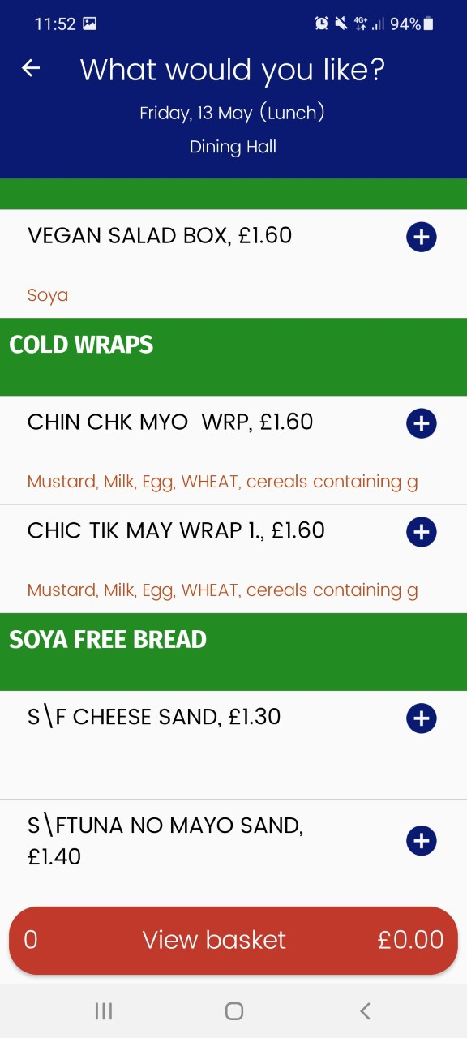
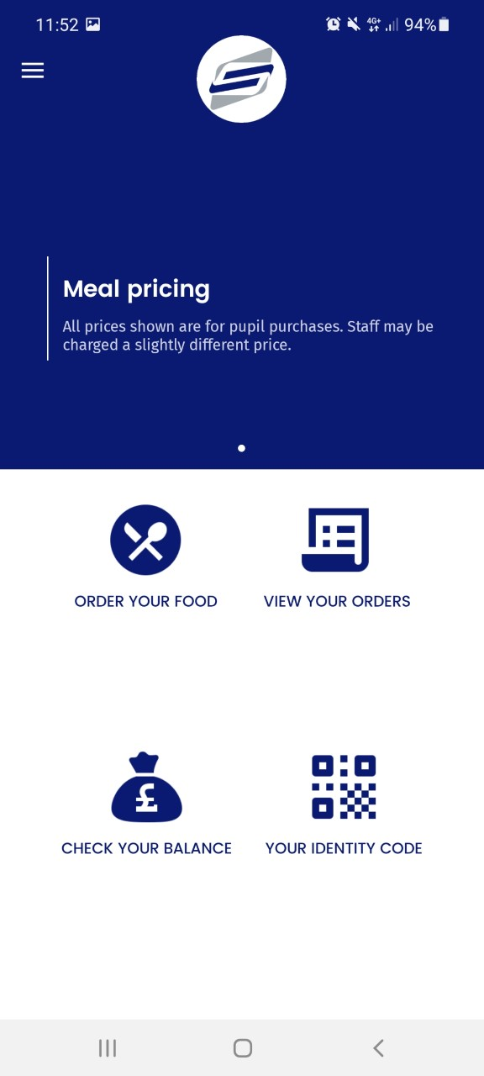
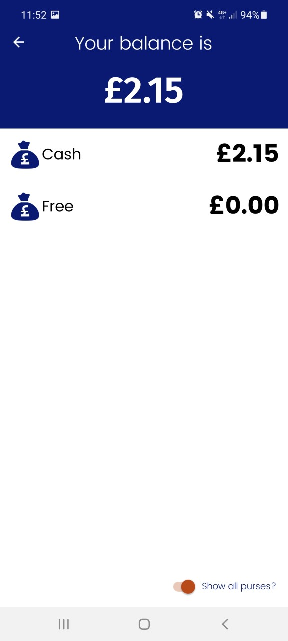
Fusion Mobile – this app is used to pre-order you lunch if you wish to

Slide 10
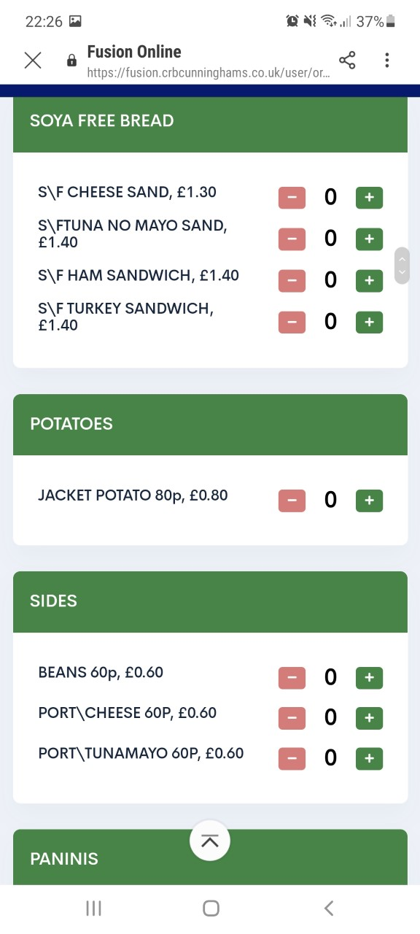
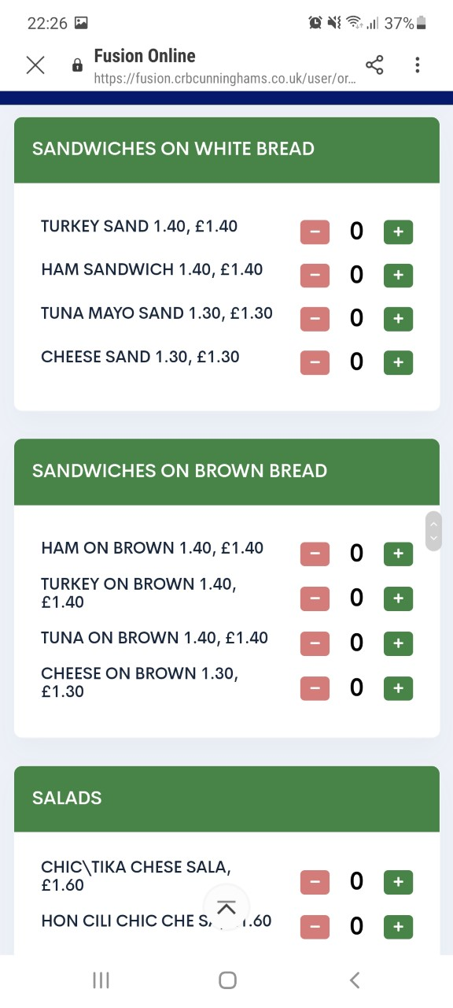
Fusion Mobile

Slide 11
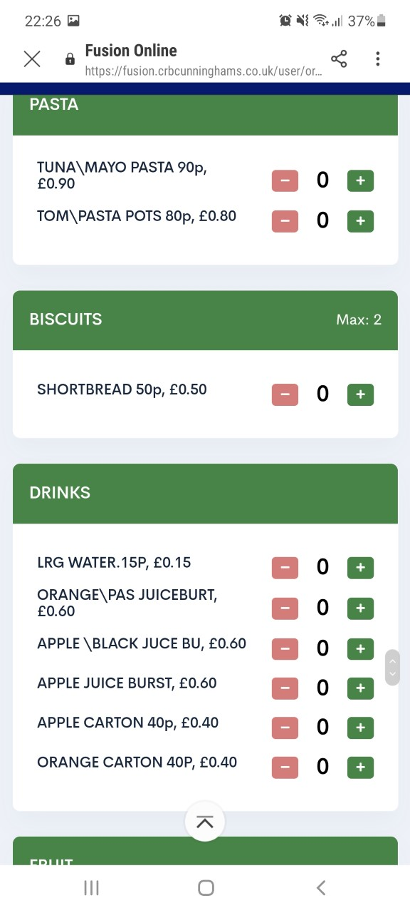
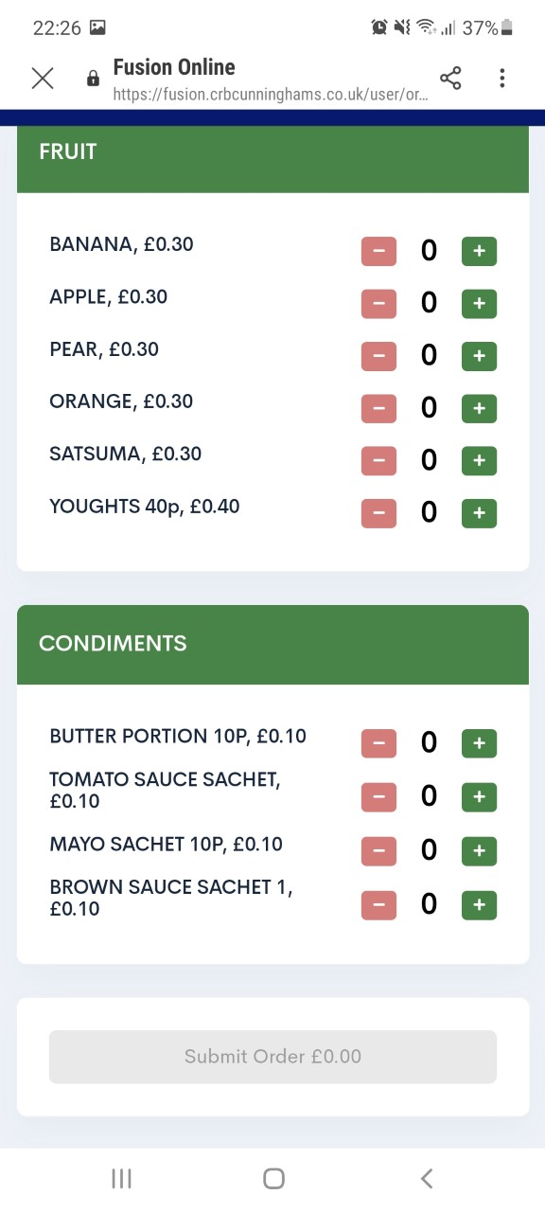
Fusion Mobile

Slide 12
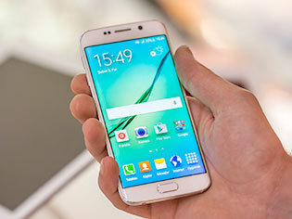
Mobile phones
You may bring a mobile phone if:
It is switched off
You keep it in your pocket or your bag
You understand it is your responsibility
If you urgently need to contact home during the school day, you see you’re a member of your Year Team.
If you use it in school (seen or heard) it will be taken from you until your parent/carer can come and collect it.

Slide 13
Extra-Curricular - https://www.stbedesblackburn.com/extracurricular/

Slide 14
